Slide 1
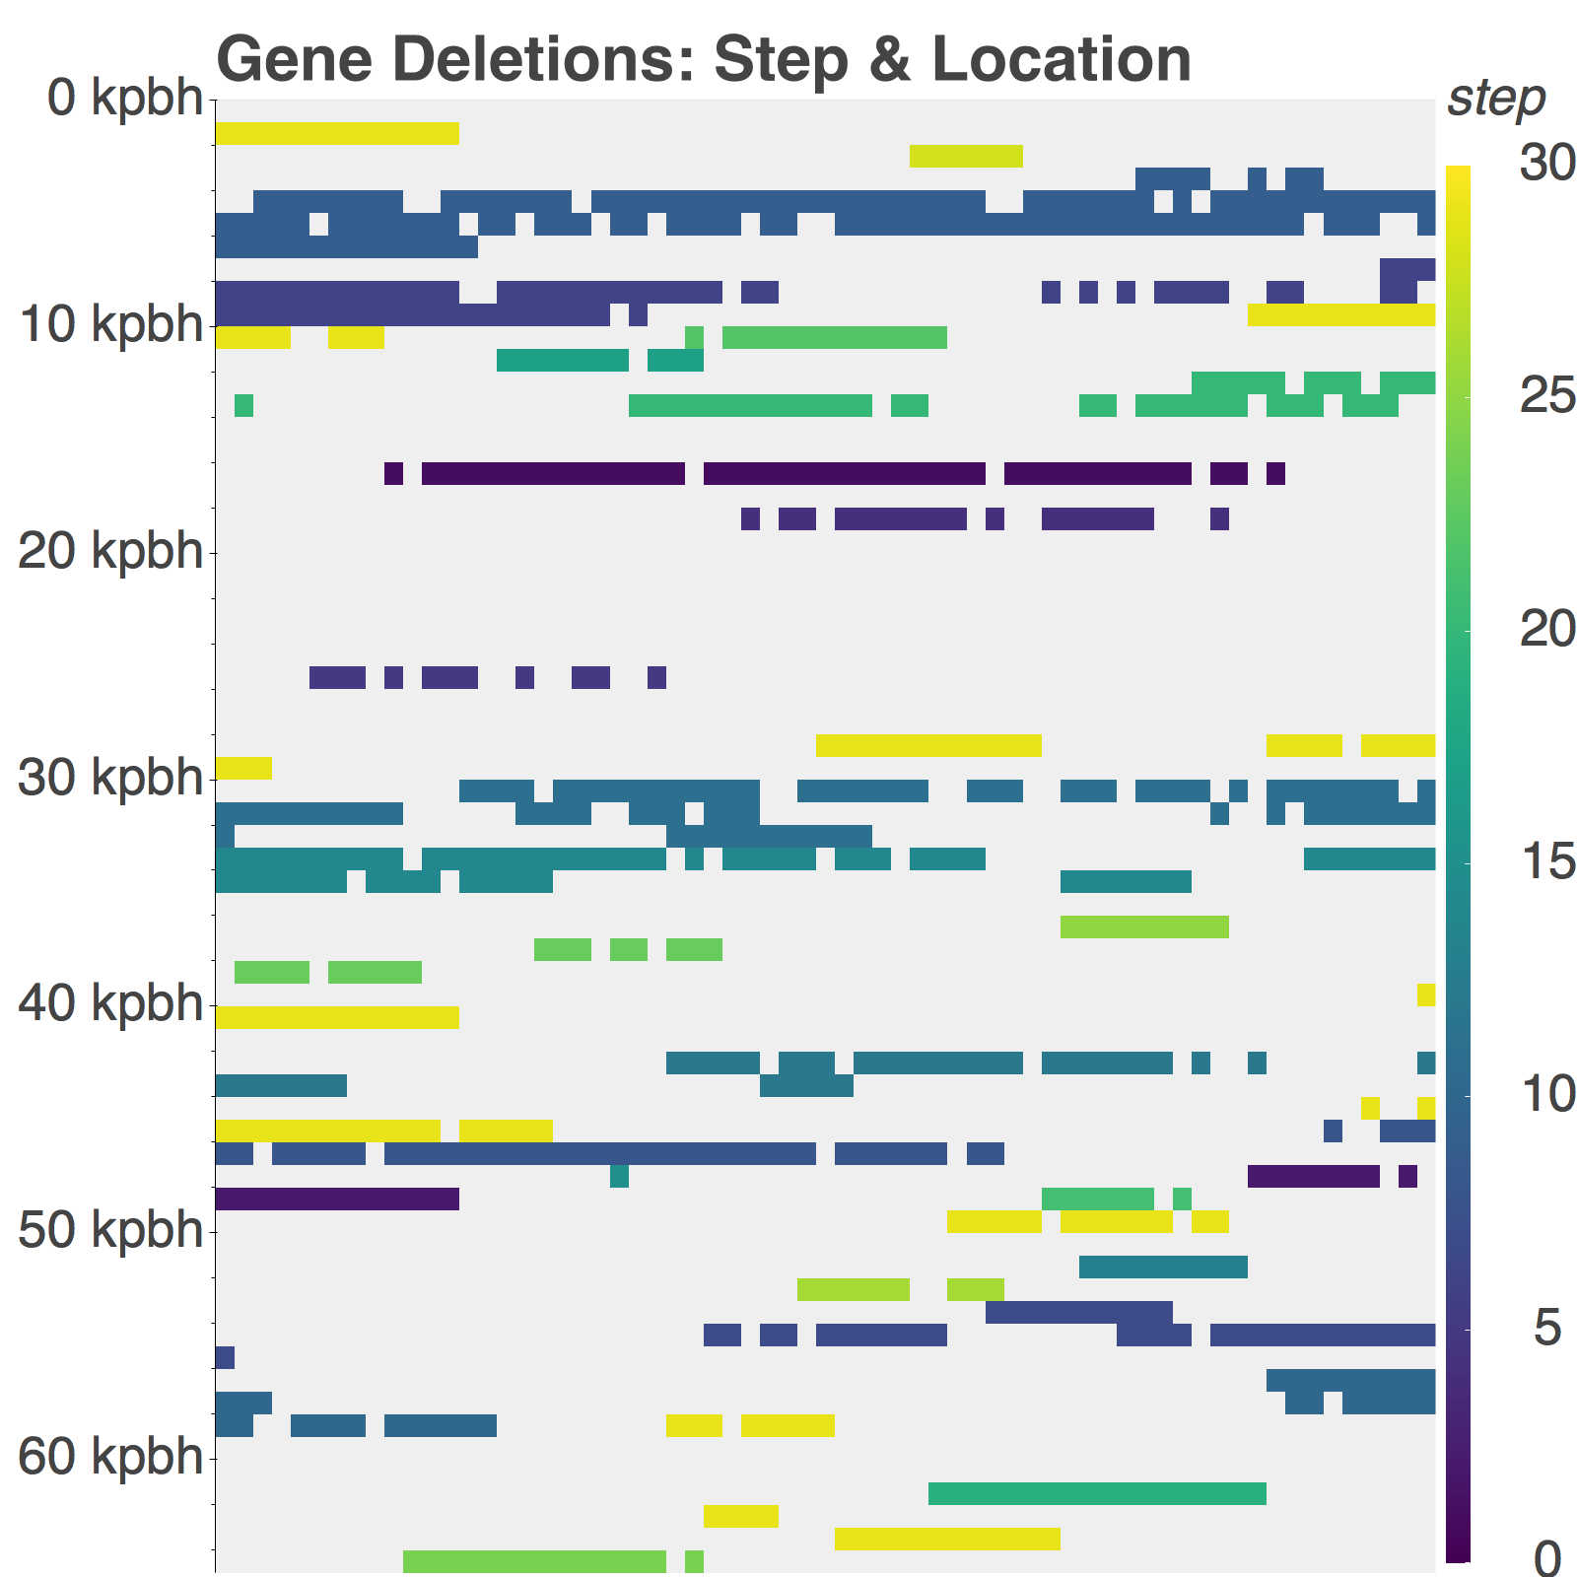
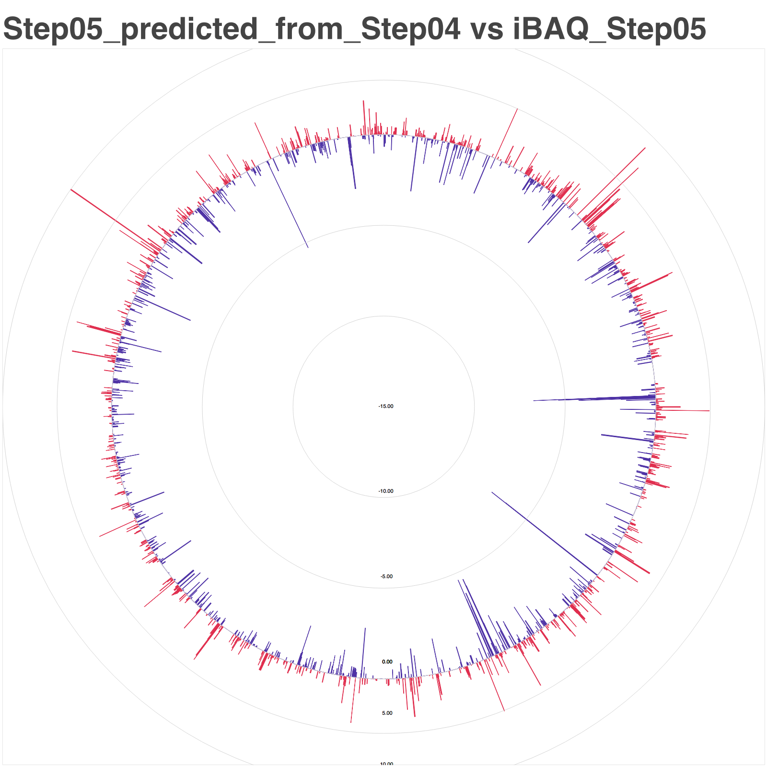
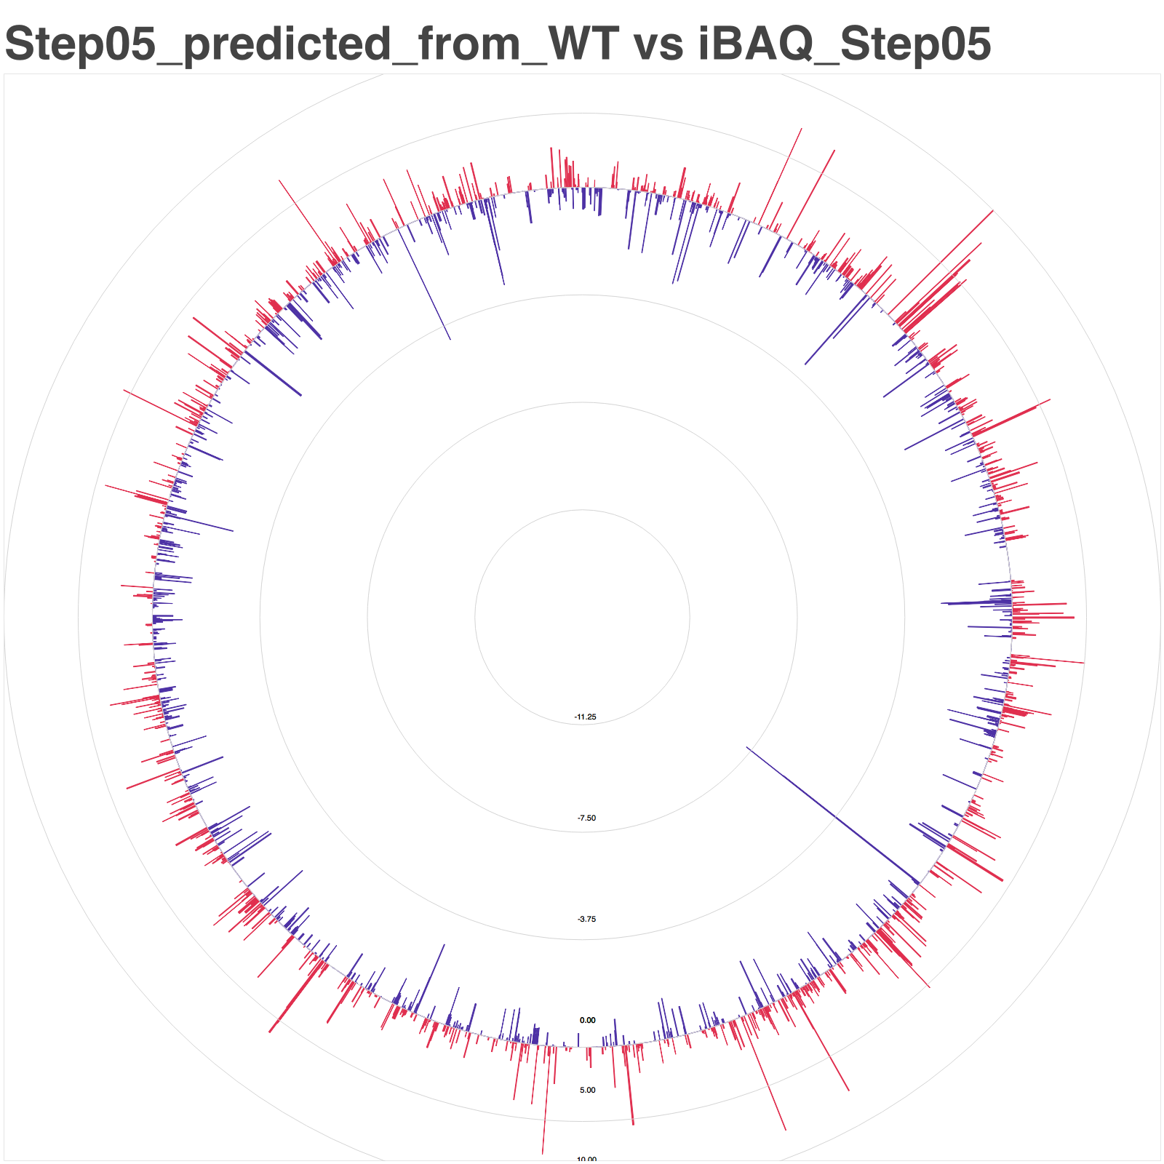
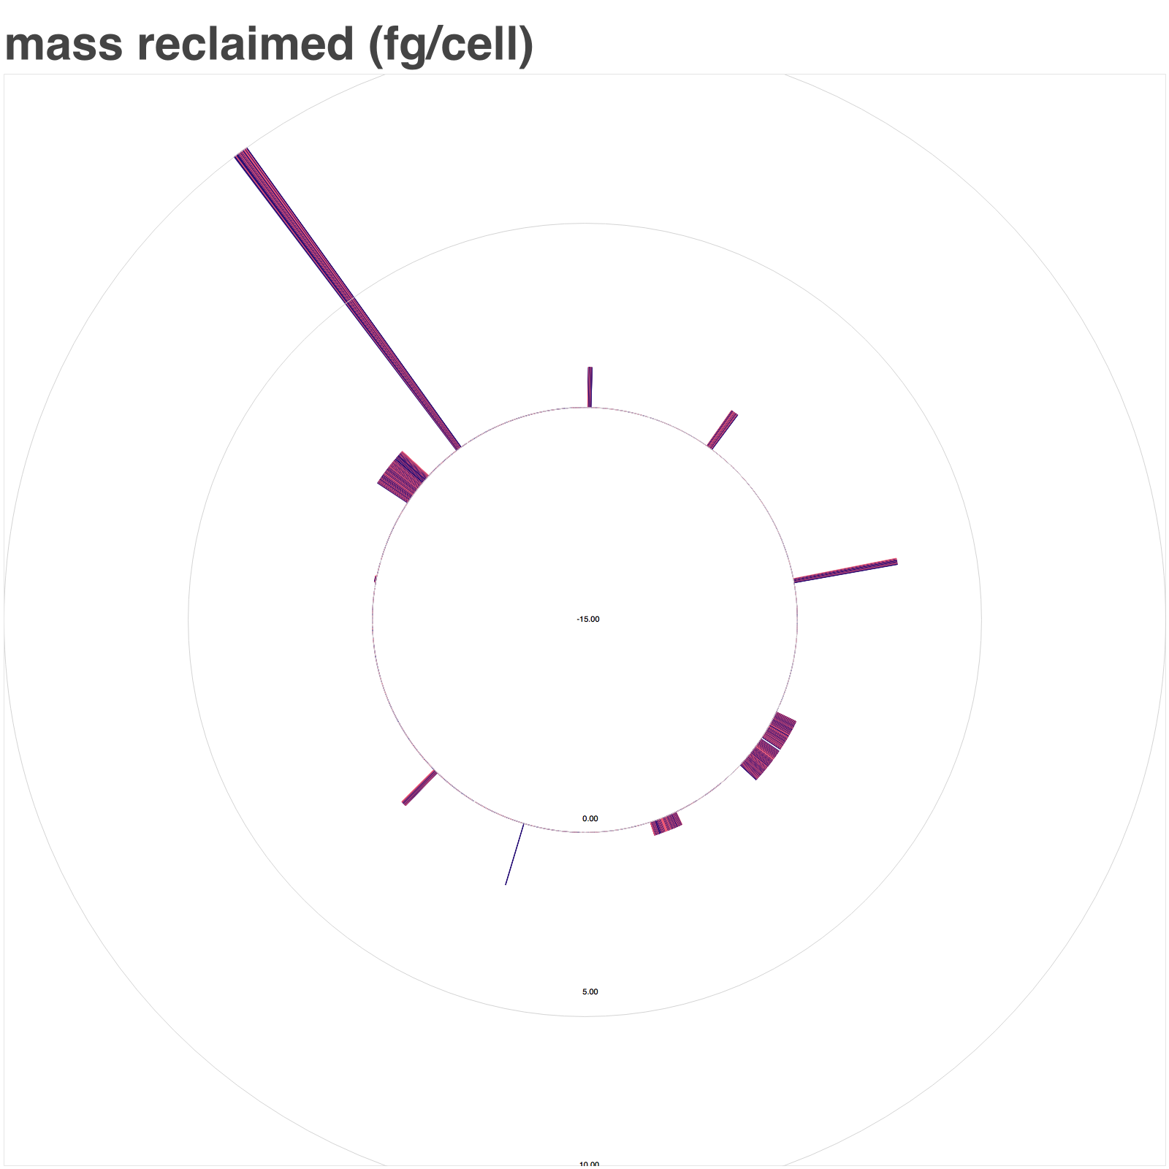
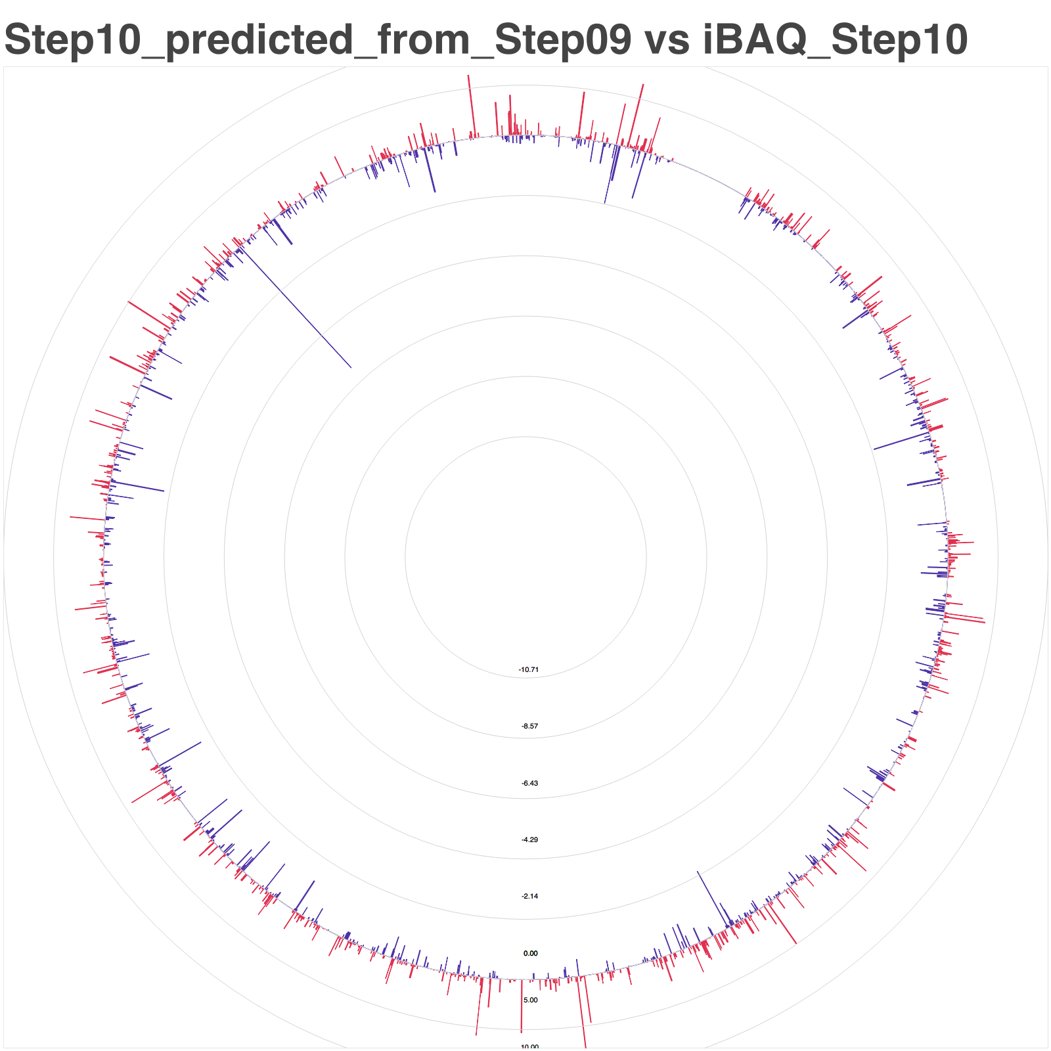
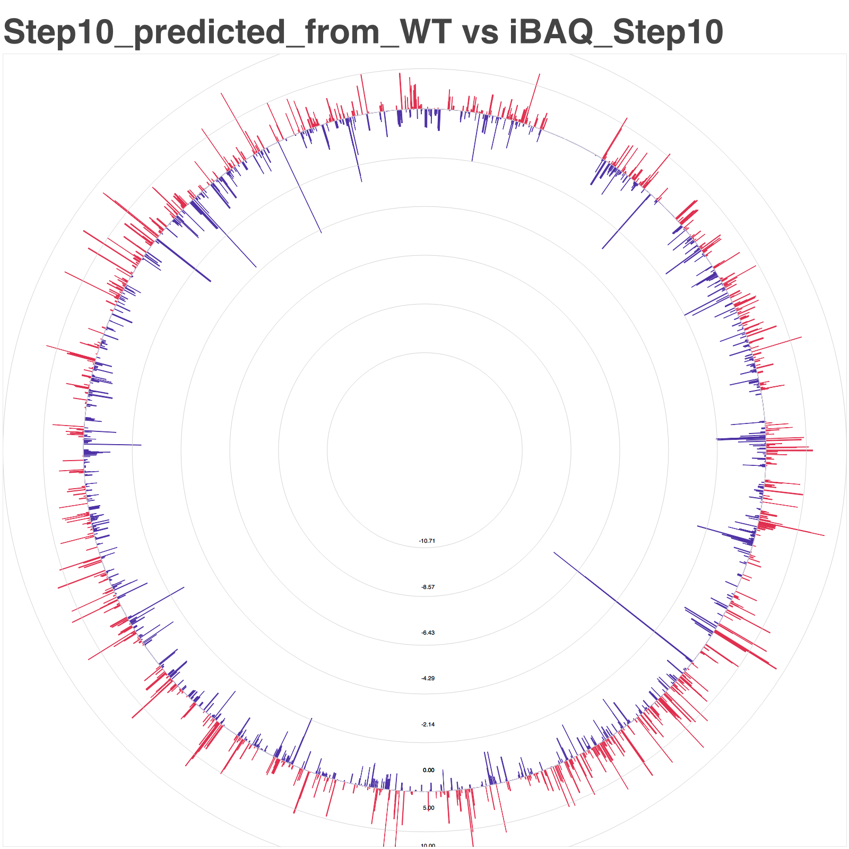
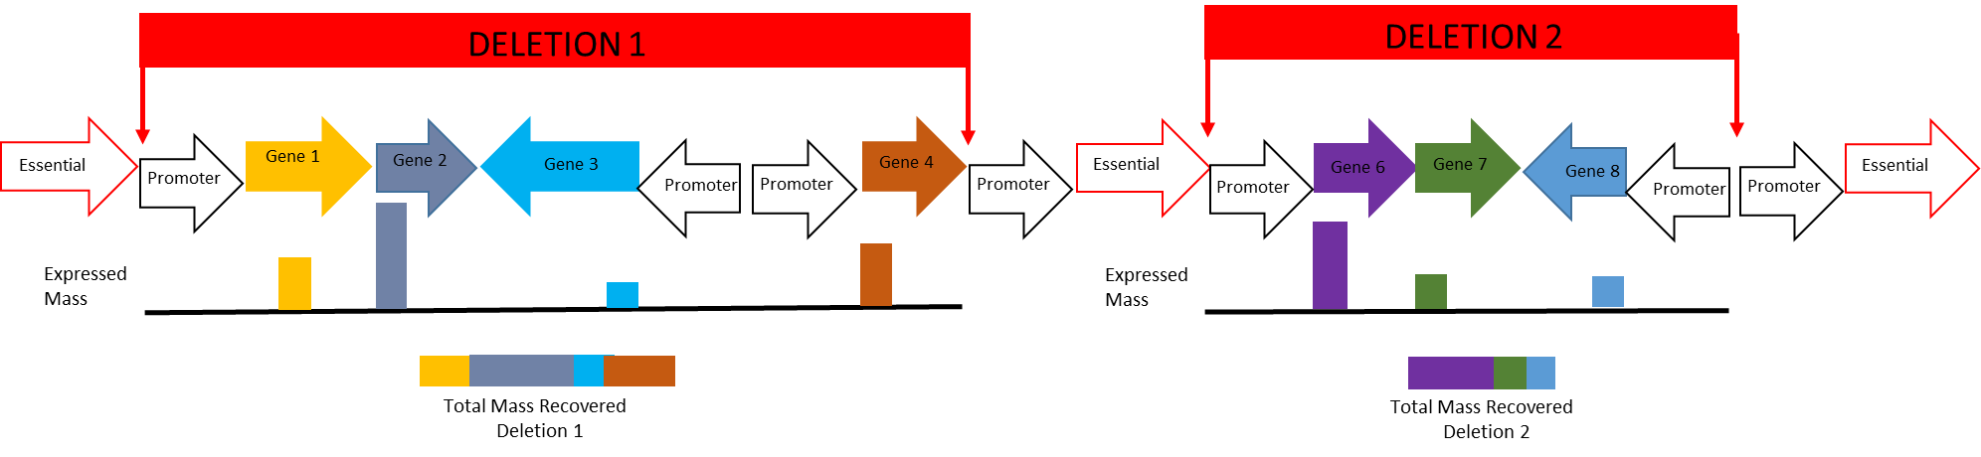
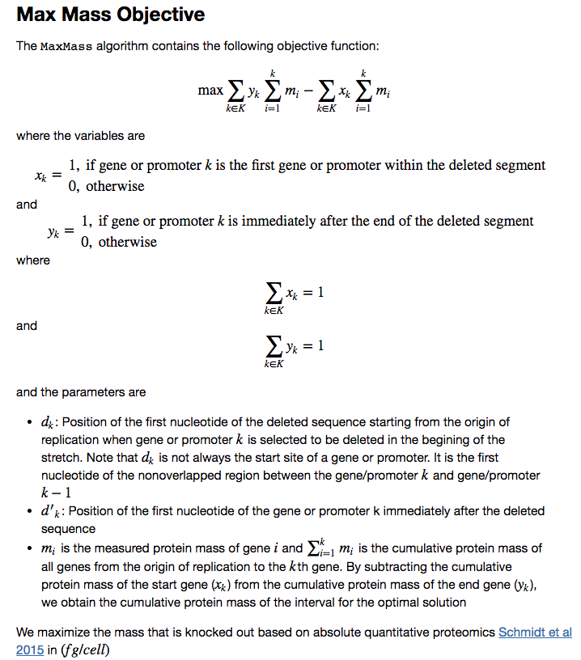
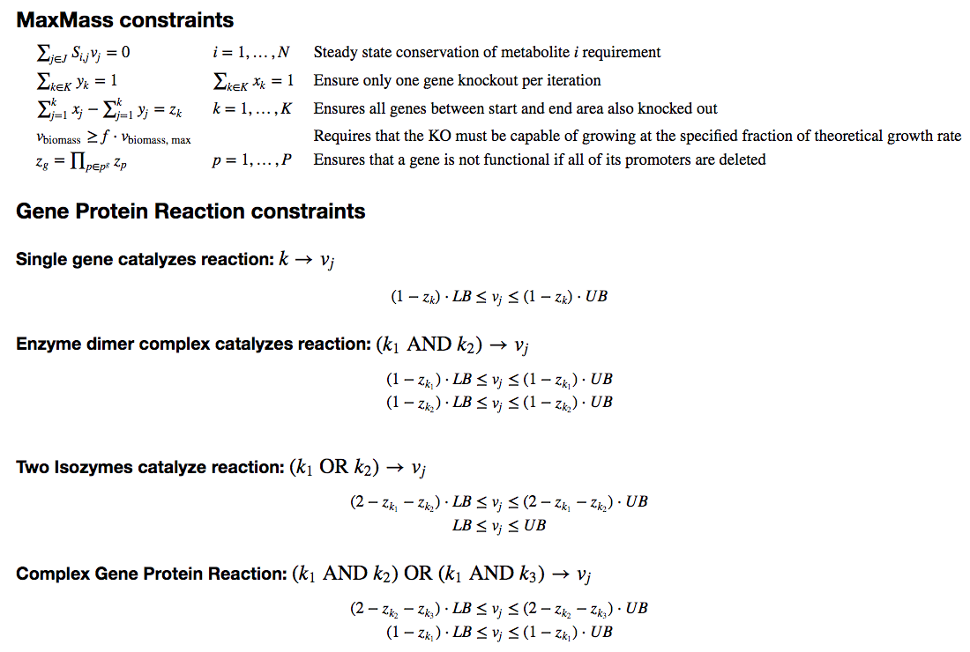

Optimal Protein Reclamation with MaxMass
Making Room for Bioproduction via Intelligent Reduction of the Host Proteome
Jeremy Zucker, Neeraj Kumar, Joseph Cottam, Jeremy Teuton, Robert Egbert
Introduction/Motivation:
Results:
Macromolecular crowding and ribosomal capacity are biophysical constraints on the ability of microbial cell factories to produce proteins of interest at sufficient titer, rate and yield to become economically viable [1,2]. To address these issues directly, the Cellular Capacity Optimization project aims to iteratively knock out nonessential regions of the genome that code for highly expressed proteins in order to reclaim that protein capacity for engineered proteins. In order to rationally guide this process, we have developed MaxMass, an algorithm for iterative reduction of the host proteome without replacement. MaxMass automatically calculates which genes are essential for the current environment and iteration, and uses these essential genes as constraints on the size of the knockout region [3], while optimizing for maximum protein mass reclamation.
Overpredicted: 55%
Underpredicted: 45%
Net predicted: 10%
Overpredicted: 60%
Underpredicted: 40%
Net predicted: 20%
Overpredicted: 51%
Underpredicted: 49%
Net predicted: 2%
Overpredicted: 55%
Underpredicted: 45%
Net predicted: 10%
Protein expression of previous strains tends to overestimate subsequent KO protein expression
To evaluate the ability of the algorithm to predict protein reclamation, we used proteomics data obtained from the KHK collection of knockouts [4]. As a baseline first step, we wished to assess how well the protein distribution of the previous step was able to predict the protein distribution of subsequent steps by assuming that the only expression change between steps were the genes that were knocked out.
MaxMass predicts 27% protein reclamation with 10 knockouts
Applied MaxMass using the protein expression from wild-type E. coli strain W3110 under minimal media [5] in order to predict which gene knockouts would result in the largest amount of protein reclamation. The results of MaxMass are displayed in the figures above. We predict that 27% of the total protein mass (48 fg protein/cell out of 180 fg total protein/cell) can be reclaimed after 10 knockouts.
Methods:
Discussion/Future Work:
Proteome prediction based on previous measurements overestimated the actual proteome measurement, but immediately prior steps were better estimators of proteome than wild-type. Interestingly, wild-type protein expression is a better estimator of Step10 (10% net error) than Step05 (20% net error). Knocking out the most highly expressed proteins can result in new highly expressed proteins. To predict which proteins must be overexpressed in the knockout, future work will focus on extending the metabolic model with RNA and Protein expression mechanisms, known as ME-models. We will apply MaxMass to other organisms such as Pseudomonas flourescens, Shewanella oneidensis MR-1 and E. coli Nissle.
References
Rivas, Germán et al. (2016) Macromolecular Crowding In Vitro, In Vivo, and In Between. Trends in Biochemical Sciences , Volume 41 , Issue 11 , 970 – 981
Jewett, M. C., Miller, M. L., Chen, Y., & Swartz, J. R. (2009). Continued protein synthesis at low [ATP] and [GTP] enables cell adaptation during energy limitation. Journal of Bacteriology, 191(3), 1083–91. https://doi.org/10.1128/JB.00852-08
Wang, L., & Maranas, C. (2017). MinGenome: An in silico top-down approach for the synthesis of minimized genomes. ACS Synthetic Biology, acssynbio.7b00296. https://doi.org/10.1021/acssynbio.7b00296
KHK Collection https://shigen.nig.ac.jp/ecoli/strain/
Schmidt, A., Kochanowski, K., Vedelaar, S., Ahrné, E., Volkmer, B., Callipo, L., … Heinemann, M. (2016). The quantitative and condition-dependent Escherichia coli proteome. Nature Biotechnology, 34(1), 104–110. https://doi.org/10.1038/nbt.3418
Notes:
NOTE: Print this poster file at 200% SCALE to result in a physical print measuring 60” wide x 42” tall. All type size notations shown above are based on the final printed size of the poster.
• Contact Digital Duplicating (375-2969, http://digitalduplicating.pnl.gov) to order poster printing and finishing services for your completed poster design.
• Remember to have your poster cleared for public display/distribution through the Information Release system (http://informationrelease.pnl.gov).
• Sidebar “About PNNL” box is considered optional, and can be removed if space is needed for technical content.

